Slide 1
An Introduction to Flutter
Don Ward
Quicken Loans
Senior Research Engineer
donward@quickenloans.com

Slide 2


Who am I?
Led Quicken Loans Mobile Team for a few years
Founder and Co-Lead GDG Detroit for 7 years
Founder and Leader of GDG Windsor ~ 1 year

Slide 3

Quicken Loans
TECHNOLOGY

Slide 4
Notes:
QL Culture

Slide 5
The Agenda
What is Flutter?
What is Dart?
Why?
Let’s code!

Slide 6

What is Flutter?
Open Source Cross Platform Mobile Development
Announced 2015
Flutter 1.0 – Dec 2018
Flutter 1.5 – May 2019
Available on iOS, Android, ChromeOS and Web

Slide 7
What is Dart?
Since 2011
Statically typed language similar to JavaScript and Java
Object-oriented
Syntactic sugar

Slide 8

‘Why?’

Slide 9
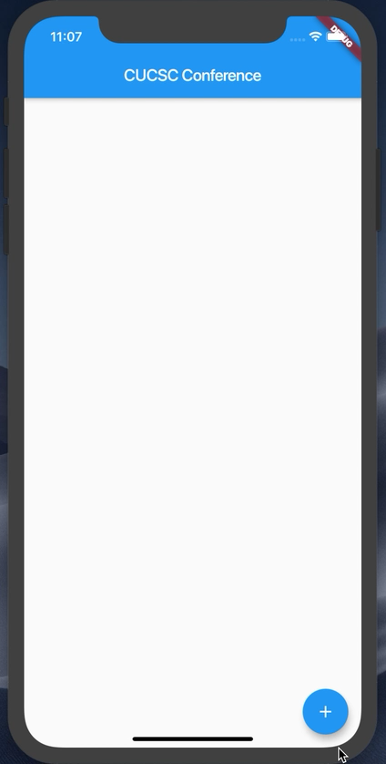
What are we building today?

Slide 10
Let’s start
Flutter SDK installed
Visual Studio Code installed
Android emulator or iOS simulator running
https://github.com/donwardpeng/flutter_intro_cucsc

Slide 11
Let’s talk about the Command Line Tool (CLI)
‘flutter doctor’
‘flutter create <app_name>’
In the <app_name> directory -> ‘flutter run’
Hot Reload and Restart
While running, type ‘h’

Slide 12
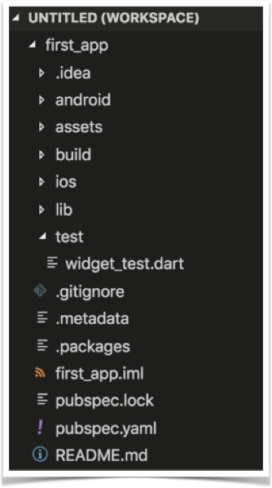
Project Structure

Slide 13
Let’s start from scratch
In VS Code, open the main.dart file
Wipe it clean
Add the code below
//Example 1
import 'package:flutter/material.dart';
void main() {}

Slide 14
Let’s attach something to the screen
The runApp method
In Dart, ‘=>’ is equivalent to {return expr};
//Example 2
import 'package:flutter/material.dart';
void main() => runApp(<Widget>);

Slide 15
‘Let’s talk about Widgets’

Slide 16
Widgets
Everything is a widget
Stateless – display only
Stateful – maintains some internal state
class StatelessWidgetExample extends StatelessWidget{};
class StateFullWidgetExample extends StatefulWidget{};

Slide 17
Let’s create our first Widget
//Example 3
import 'package:flutter/material.dart';
void main() => runApp(MyApp());
class MyApp extends StatelessWidget{
@override
Widget build(BuildContext context) {
// TODO: implement build
return null;
}
}

Slide 18
Let’s add some Material Design
//Example 4
@override
Widget build(BuildContext context) {
return MaterialApp(
title: ‘CUCSC Conference’,
);
}
}

Slide 19
‘Let’s talk about Constructors!’

Slide 20
Widgets & Constructors
Positional and Named Parameters
Flutter -> heavily relies on Named Parameters
Named Parameters declared with {}
Example – the Text Widget

Slide 21
The Text Widget
Text(String data, { Key key, TextStyle style, StrutStyle strutStyle, TextAlign textAlign, TextDirection textDirection, Locale locale, bool softWrap, TextOverflow overflow, double textScaleFactor, int maxLines, String semanticsLabel })

Slide 22
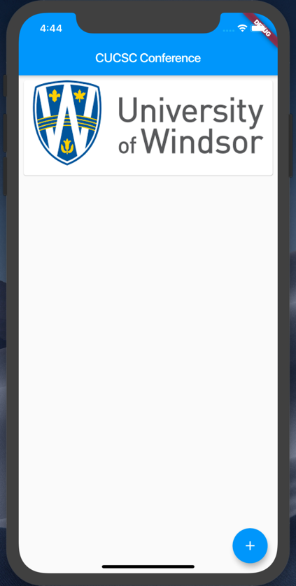
Let’s add some Widgets
Add a Card per Image
Add a Floating Action Button

Slide 23
Add a Scaffold for the Screen
//Example 5
return MaterialApp(
title: 'CUCSC Conference',
home: Scaffold(
appBar: AppBar(
title: Text('CUCSC Conference'),
),
));

Slide 24
Add a Card to the Body
//Example 6
home: Scaffold(
appBar: AppBar(title:Text(‘CUCSC Conference’),),
body: Card(child: ,));
}
}

Slide 25
Add a Column to the Card
//Example 7
... appBar: AppBar(
title: Text(‘CUCSC Conference’),
body: Card(child: Column(children: <Widget>[],),
),
));
}...

Slide 26


Let’s add some images
Steps:
Create a new assets folder and add images
Modify pubspec.yaml file

Slide 27
Add a Image to the Card
//Example 8
...
child: Column(
children: <Widget>[
Image.asset(‘assets/cucsc.png'),
],
),...

Slide 28
Guess what – Padding is a Widget
//Example 9
Below the Image...
Padding(padding: const EdgeInsets.all(8),
),
],
),
)));...

Slide 29
Margin is inside a Widget
//Example 10
...
body: Card(
margin:EdgeInsets.all(8),
child: Column(
children: <Widget>[
Image.asset(‘assets/cucsc.png'),
...

Slide 30
ListViews give us scroll
//Example 11
...
body: ListView(
children: <Widget>[
Card(
margin: EdgeInsets.all(8),
child: Column(
...

Slide 31
Stacks give us absolute position
//Example 12
...
body: Stack(
children: <Widget>[
ListView(
children: <Widget>[...

Slide 32
Let’s add a FAB
//Example 13
<Card View code above here>...
),
FloatingActionButton(
child: const Icon(Icons.add),
onPressed: () {},
)
],
)));...
<code below here>

Slide 33
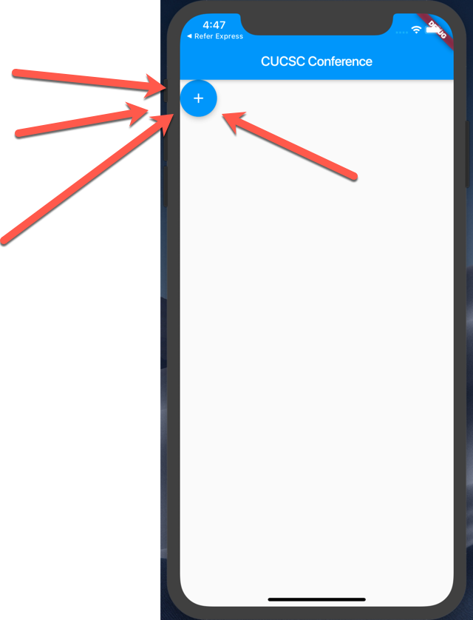
Why is the Floating Action Button (FAB) here?

Slide 34
Let’s move the FAB
//Example 14
<CardView code above here>
Positioned(
bottom: 16.0, right: 16.0,
child: FloatingActionButton(...

Slide 35
Everything is in place now. Let’s wire up the button and images to the list.
WARNING: BOILERPLATE CODE AHEAD

Slide 36
Let’s add a list of Images
//Example 15
class MyApp extends StatelessWidget {
// Declare a set list of images to cycle through
final List<Image> _itemImages = [
Image.asset('assets/cucsc.jpeg'),
Image.asset('assets/u_of_w.png'),
Image.asset(‘assets/vacation.jpg')
];
int _index = 0;
List<Image> _listOfImagesForScreen = [];

Slide 37
Boiler Plate Alert – A Stateful Class
//Example 16
class MyApp extends StatefulWidget {
@override
State<StatefulWidget> createState() {
return _MyAppState();
}
}
class _MyAppState extends State<MyApp> {

Slide 38
Let’s make the button do something
//Example 17
//Add to the main class above the build method
void onButtonPressed() {
setState(() {
_index++;
if (_index >= _itemImages.length) {
_index = 0;
}
_listOfImagesForScreen.add(_itemImages[_index]);
print('Item Name = ' + _listOfImagesForScreen.toString());
})}

Slide 39
Redraw the ListView with all of the Images every time state changes
//Example 18
ListView(
children: _listOfImagesForScreen.map((element) => Card(

Slide 40
What did we learn?
Command Line Tool for Flutter
Project Structure
Widgets
Constructors and Named Parameters
Stateless and Stateful Widgets
A few Widgets ☺
https://github.com/donwardpeng/flutter_intro_cucsc

Slide 41

Thank you!
Don Ward
Quicken Loans
Senior Research Engineer
donward@quickenloans.com

